Slide 1


Battle of the Neighborhoods
By Aswin Sureshkumar

Slide 2


CONTENTS
Introduction/Business Problem
Data
Methodology
Results and Discussion
Conclusion

Slide 3
INTRODUCTION
Toronto is the economic capital of Canada with a total area of 630.2 Sq.Kms having a population of 2,731,571 as of 2016.
Large area and populations implies that it is difficult to open a new business without knowledge of the location
Aim of the project is to identify the ideal location for opening an Italian restaurant in Toronto.

Slide 4
DATA
The data sources utilised for this project are Candidate areas in Toronto and Four Square API
Postal code data contains possible neighbourhood candidates
Four Square API contains information regarding restaurants in Toronto.

Slide 5
METHODOLOGY
The steps for achieving the goal of this project are as follows:
Data Cleaning:
The Required data are loaded and check for any redundant data.
Data Exploration:
Location data and restaurant data are combine from the two data sources and restaurants in the neighbourhoods are explored.
Machine Learning:
K-means clustering algorithm is used to group the neighbourhoods based on similarity. Elbow method is used to find the ideal value for k and it is found to be Four.

Slide 6
RESULTS AND DISCUSSION
After clustering we can see that clusters 2 and 4 contain the greatest number of Italian restaurants even though they have low number of neighbourhoods.
Clusters 1 and 3 seem to be ideal since they contain least number of Italian restaurants while having lot of neighbourhoods.
Neighbourhoods like Agincourt, Woodbine Heights, York Mills West present in cluster 1 are ideal places to start a new Italian restaurants.
Neighbourhoods like Brockton, Parkdale Village, Exhibition Place, University of Toronto and Harbord can also be taken into consideration.

Slide 7
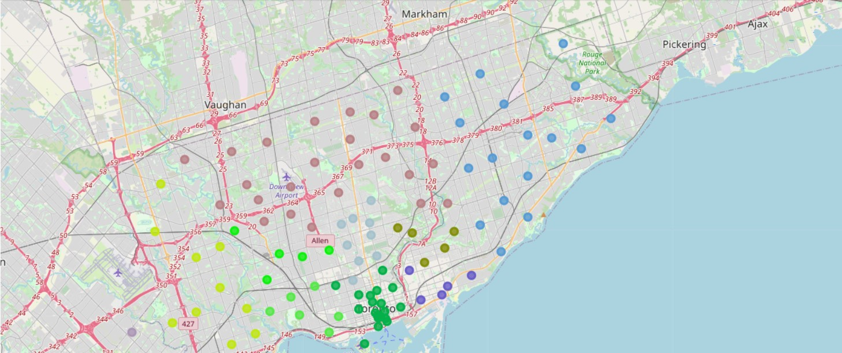
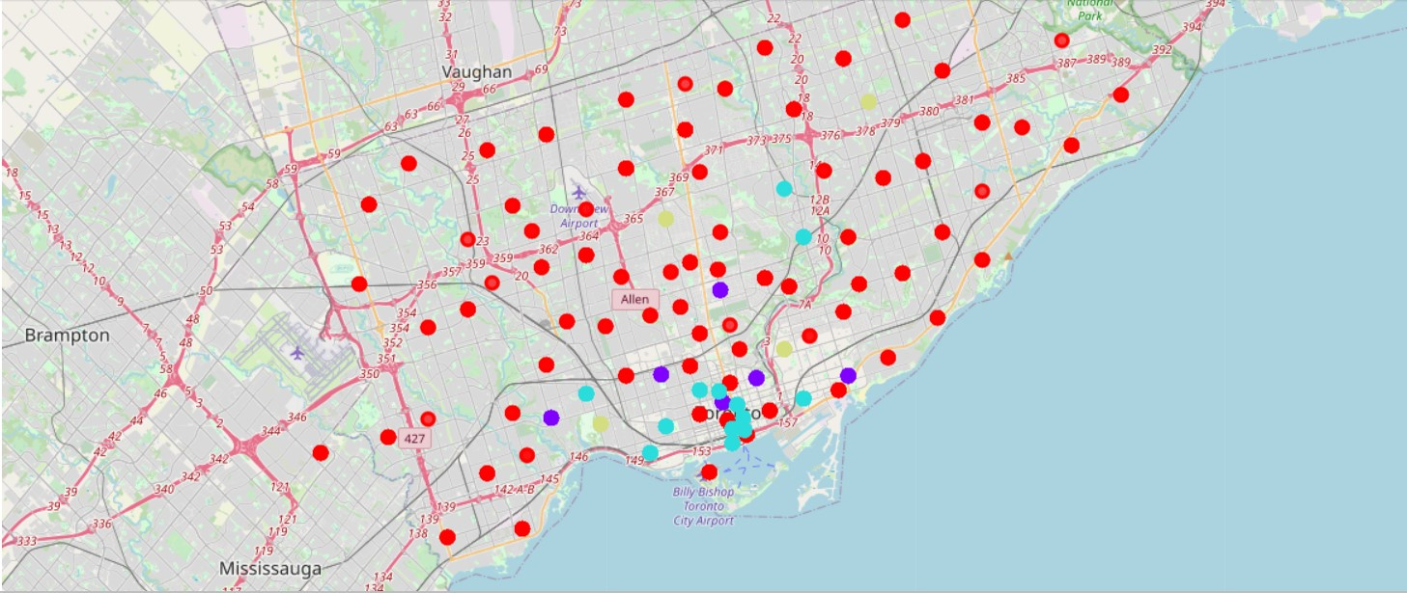
RESULTS AND DISCUSSION
Toronto Neighbourhood
Toronto Neighbourhood after clustering

Slide 8
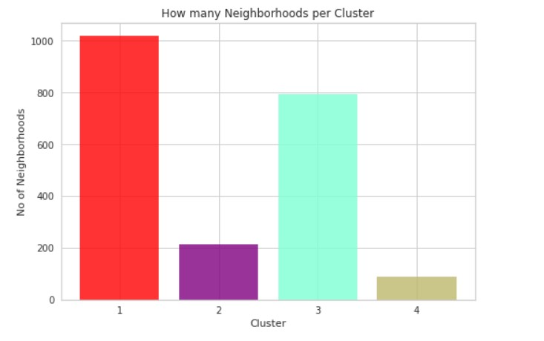
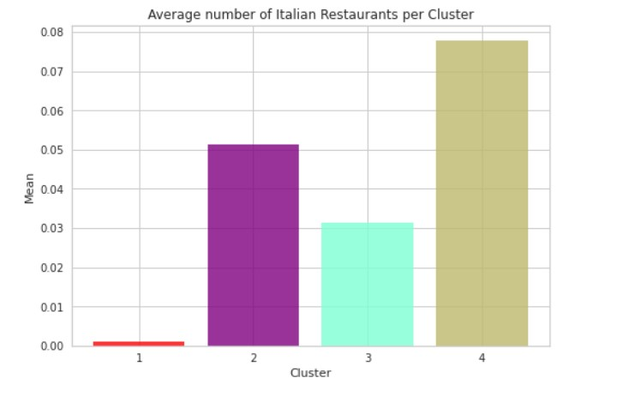
RESULTS AND DISCUSSION

Slide 9
CONCLUSION
Main goal of the project was achieved and will prove as a guide for stakeholders to start a new Italian restaurant in the ideal location.
Final decision can be taken by the stakeholders based on other factors such as real-estate availability and price.

